Slide 1

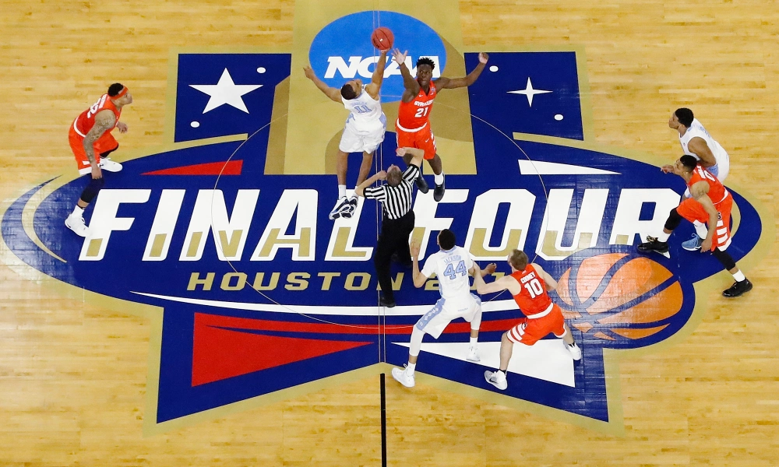

Mining March Madness
Arjun Goyal, Richard Hardis, Fred Sackfield, Anthony Temeliescu

Slide 2

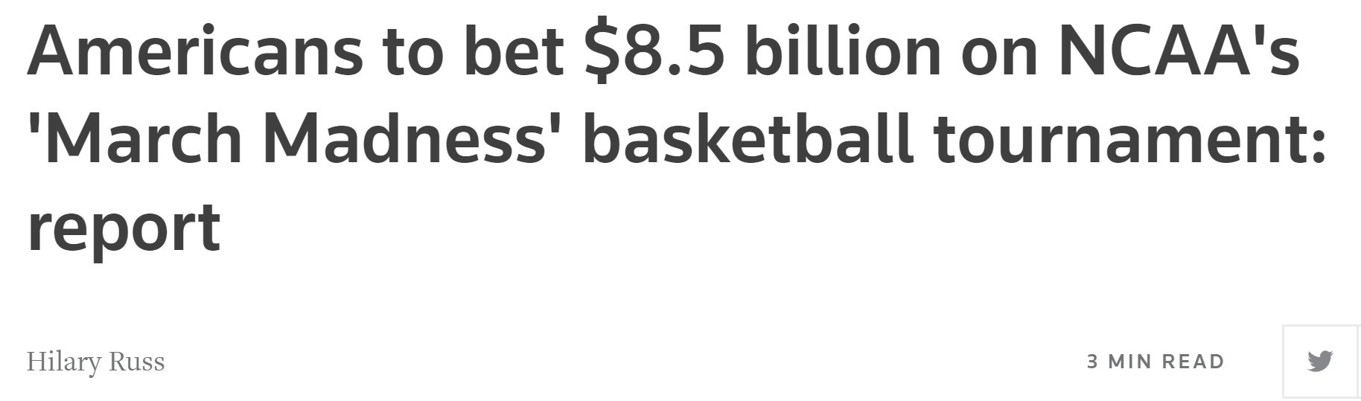
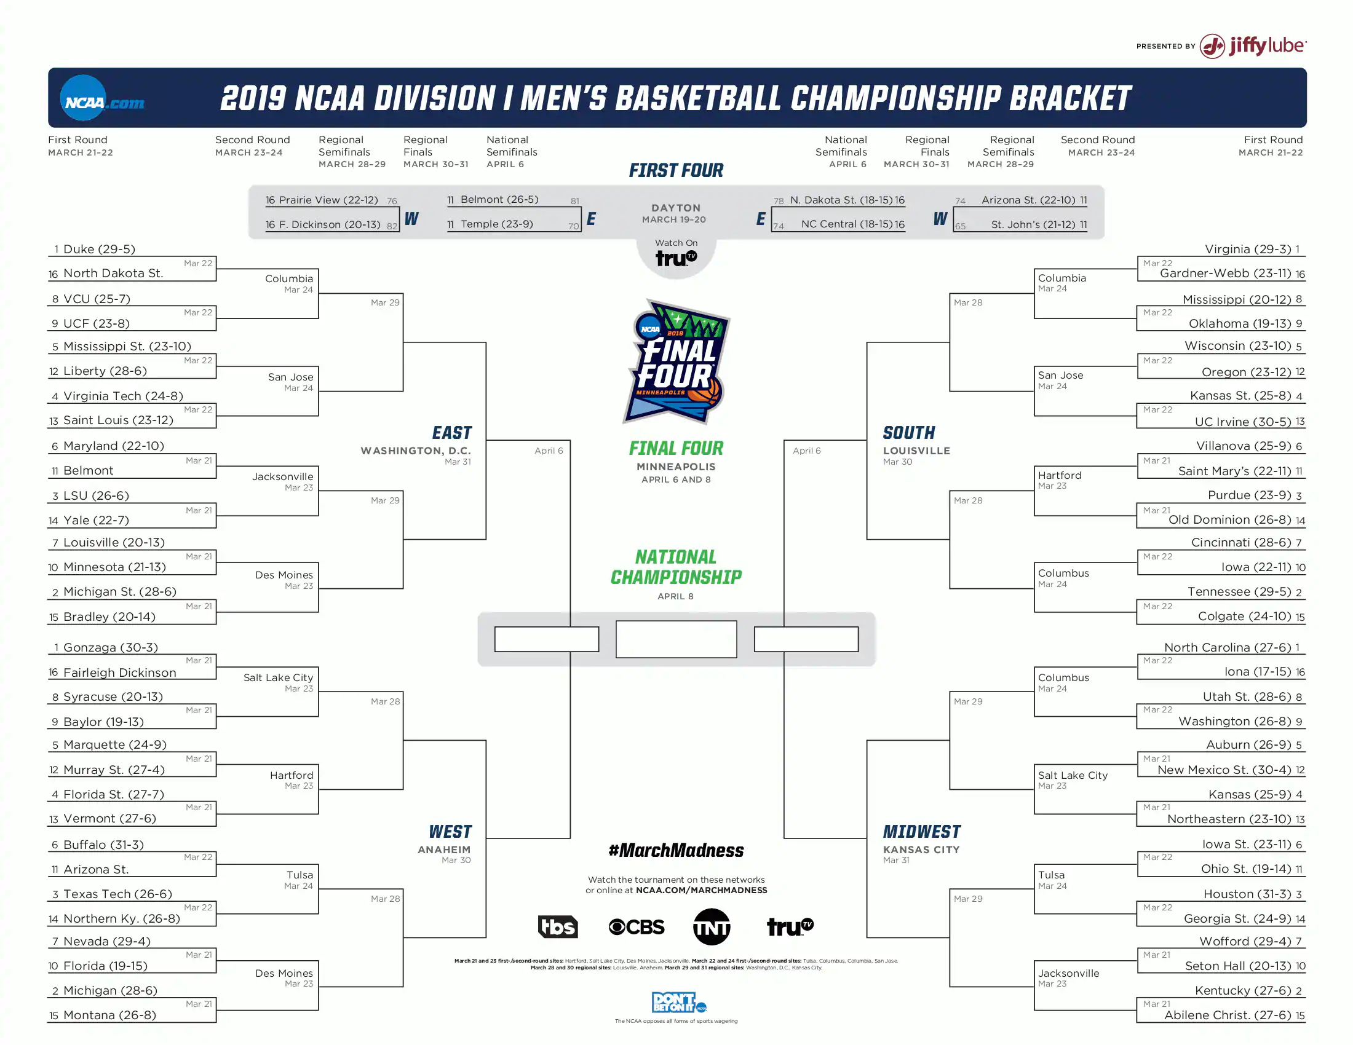
Background
1 in 5 American adults wager on March Madness.
64 teams have the chance to play 6 single-elimination games
Teams assigned seeds 1-16 in 1 of 4 starting regions
Predicting wins is not as easy. Upsets, where lower ranked teams win, happen frequently in the tournament every year.
Gamblers, statisticians, and the sports industry all try to gain insights every year on predicting the tournament’s results.

Slide 3
Objective
Predict the number of NCAA Tournament wins by team based on regular season performance metrics.
Use supervised learning methods
Develop a model with good explainability and generality

Slide 4





Data Collection
Training Data
1757 total observations over 5 seasons (1 per year per team)
28 total features
24 from Kaggle set; added ATS, Coach Total Wins, Adjusted Spread, and Coach Tourney Wins
Filtered out non-tournament teams based on modeling objective
340 total observations for modeling
Training Data
Y x1 x2 x3 ...

Slide 5
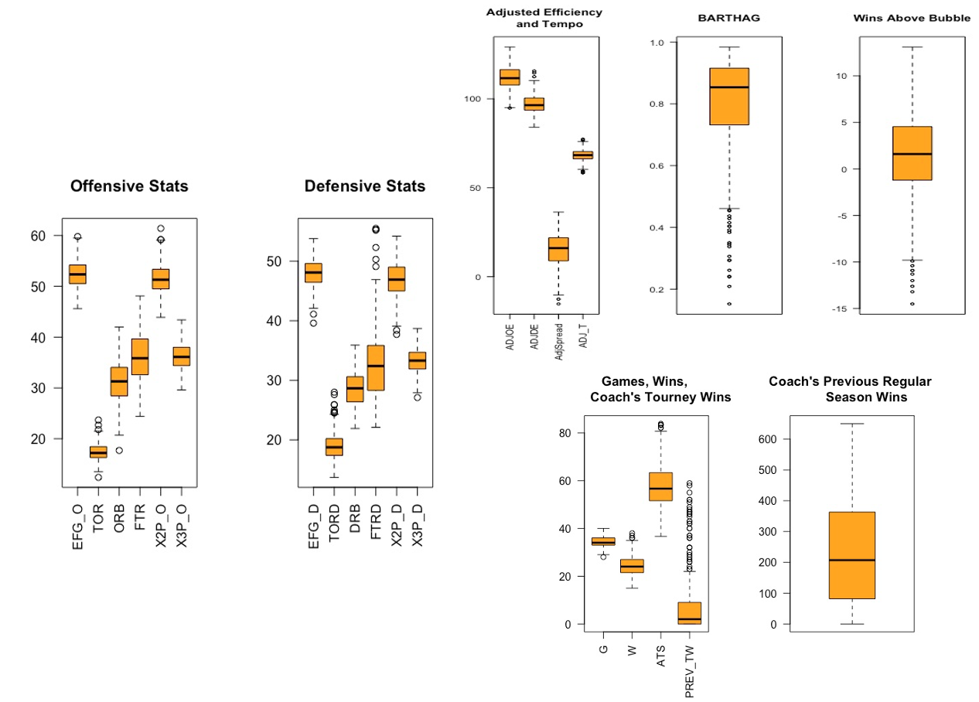
Data Exploration
Boxplots of quantitative features for visual summary and outlier detection.
BARTHAG (power rating) and Wins Above Bubble plots reflects tournament’s inclusion of strong and weak teams.
Certain teams display higher than median rates of 2-point shooting, turnovers committed, and free throw rate allowed.
Although most coaches are inexperienced in the tournament, there are a few with many previous tournament wins.

Slide 6
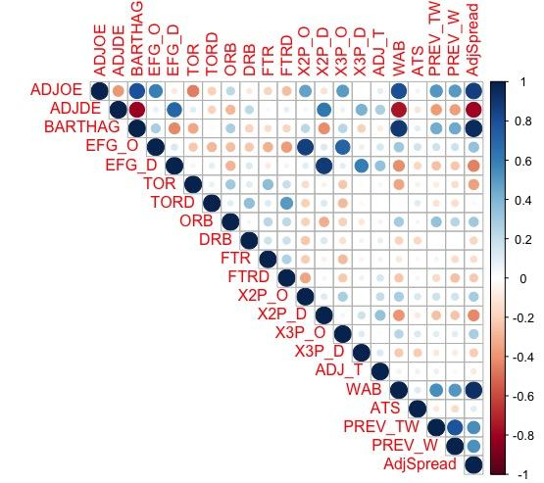
Data Exploration
Correlation matrix of quantitative features for relationship detection and multicollinearity inspection.
Offensive and defensive percentage statistics show moderate inverse correlation with each other.
Wins needed to make the tournament is strongly positively correlated with coach’s previous experience.
Some evidence of multicollinearity within offensive percentage statistics and defensive percentage statistics respectively.

Slide 7
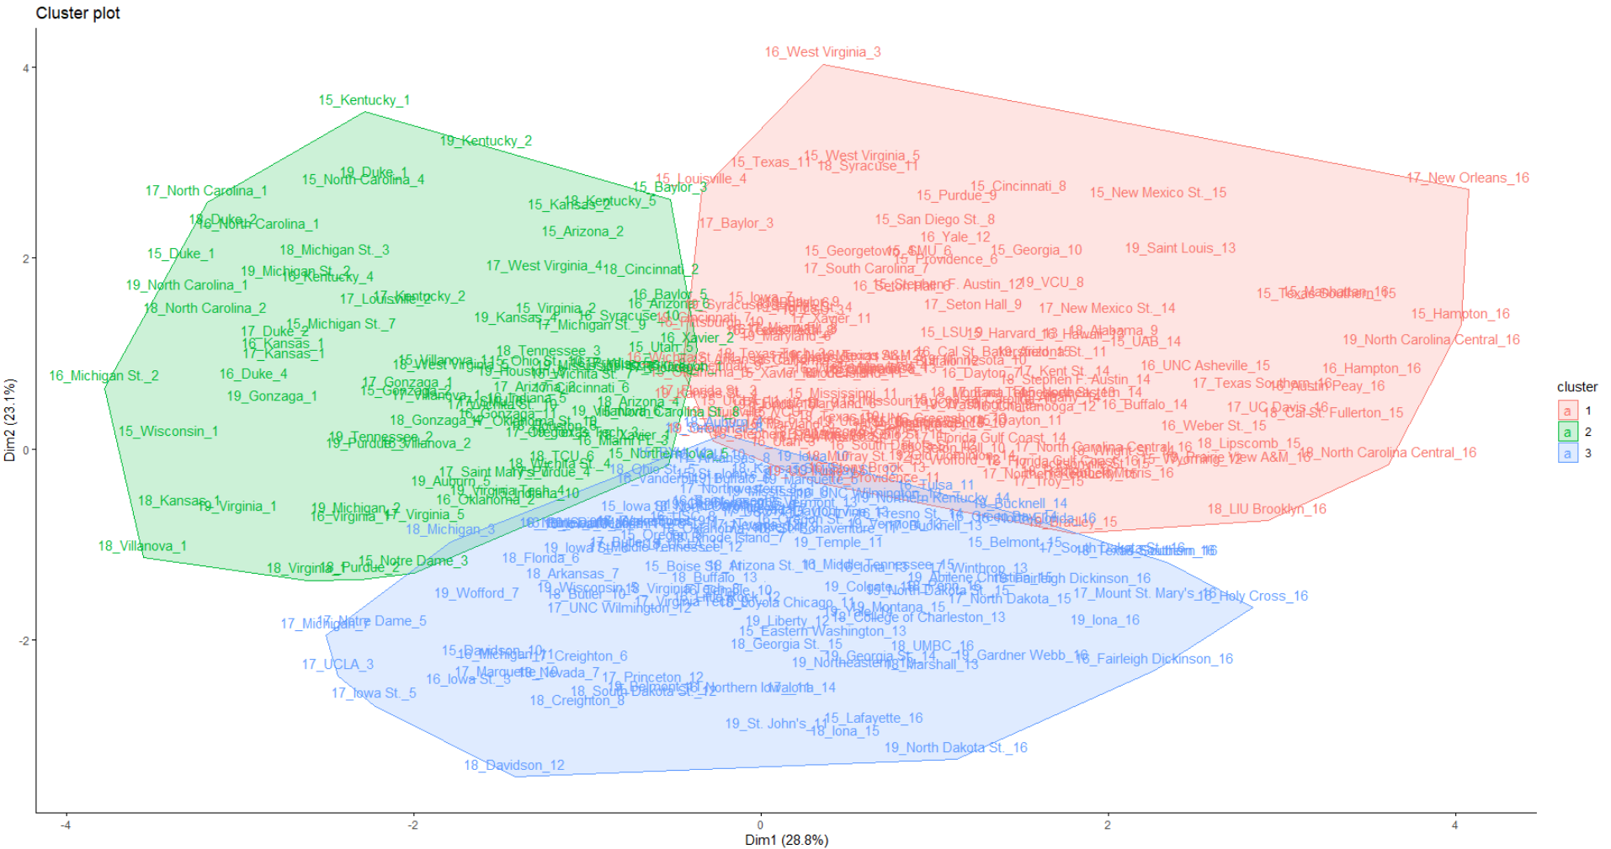
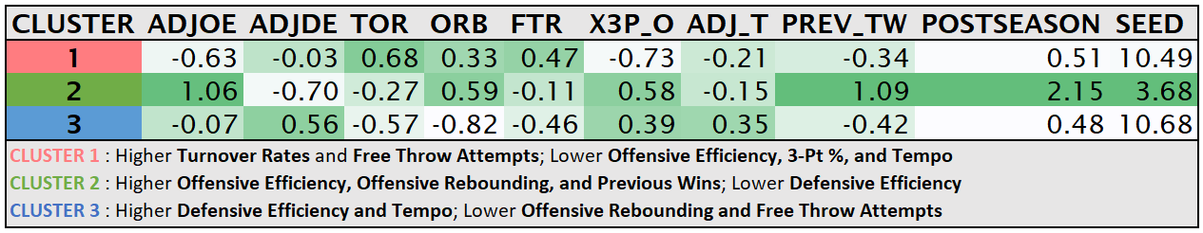
Clustering Teams by Performance Metrics with K-Means Clustering (k=3)
Label Format:
“Year_TeamName_Seed”
CONTENDERS
LONG_SHOTS
Cluster Centers:

Slide 8
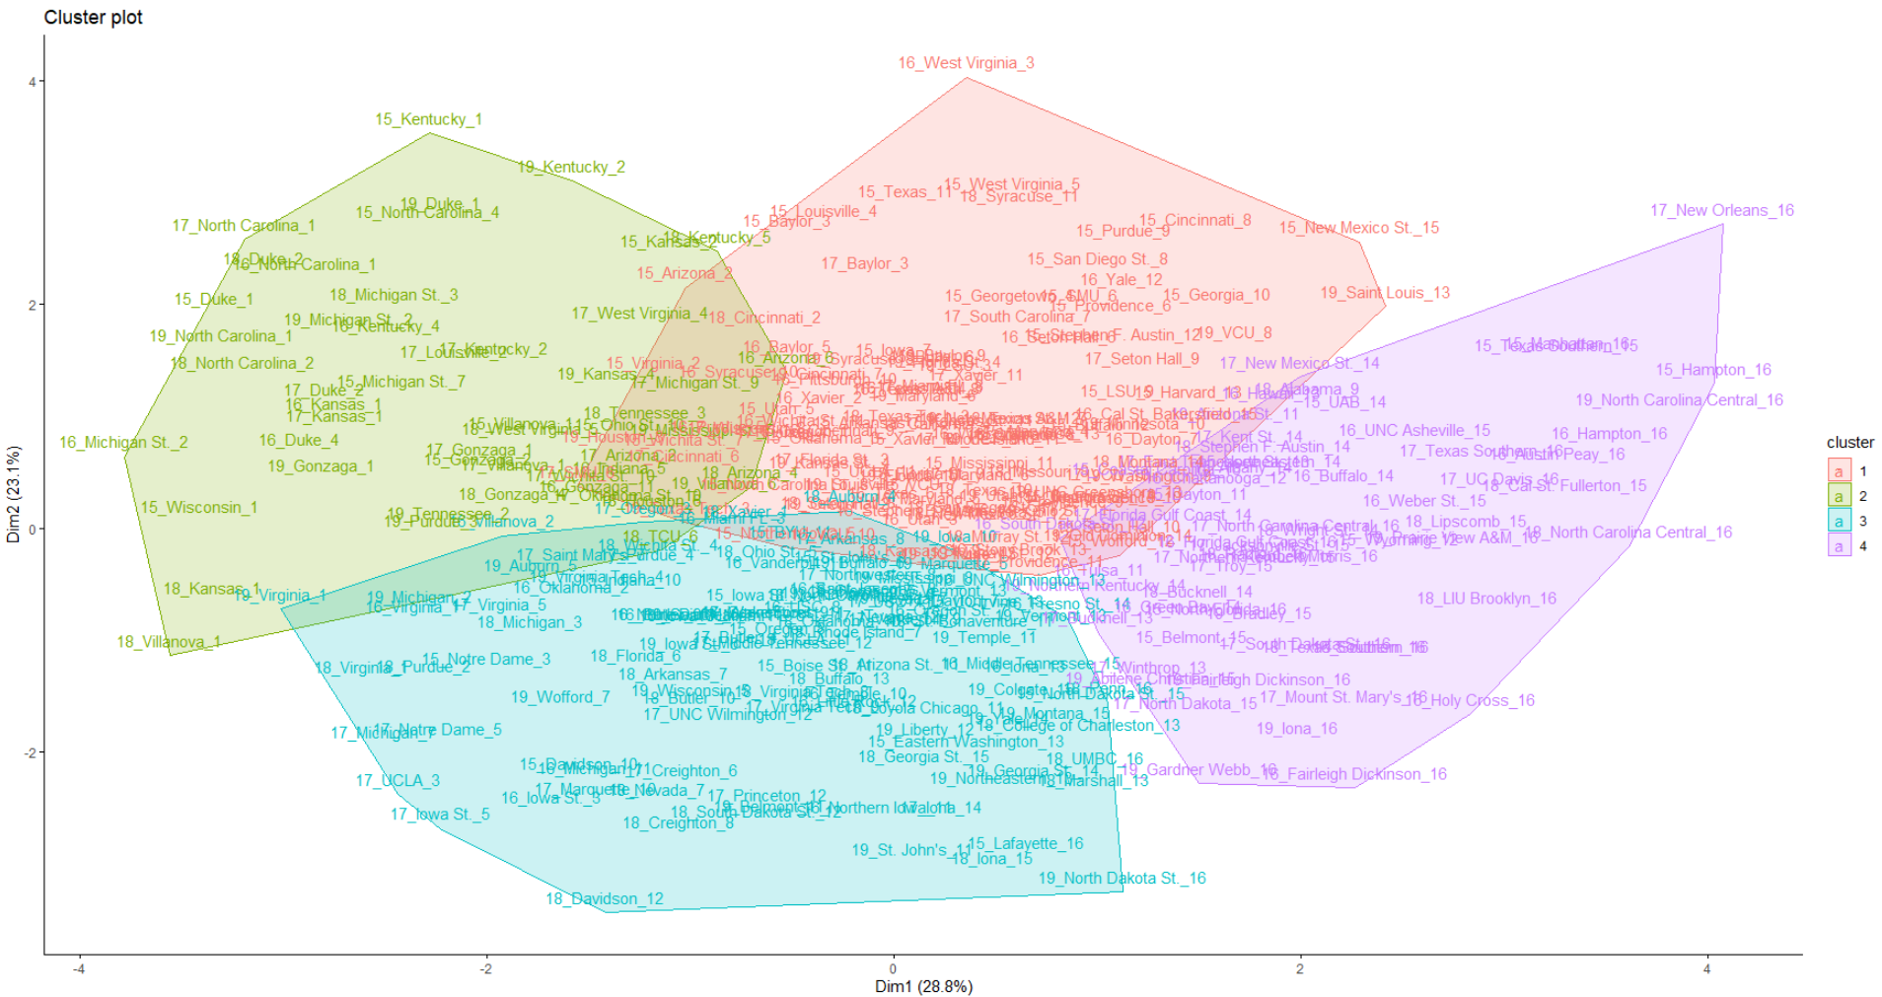
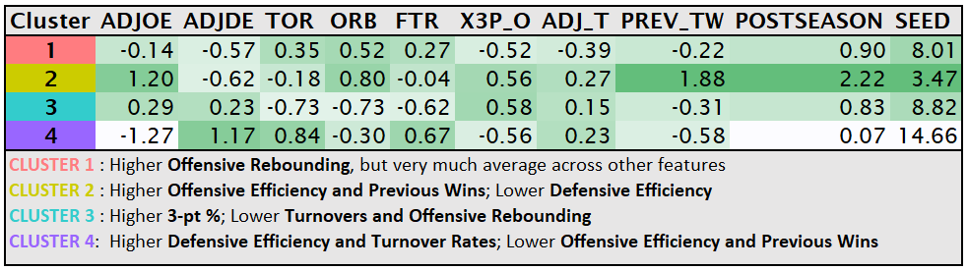
Clustering Teams by Performance Metrics with K-Means Clustering (k=4)
1-WIN TEAMS
Label Format:
“Year_TeamName_Seed”
LONG-SHOTS
CONTENDERS
1-WIN TEAMS
Cluster Centers:

Slide 9
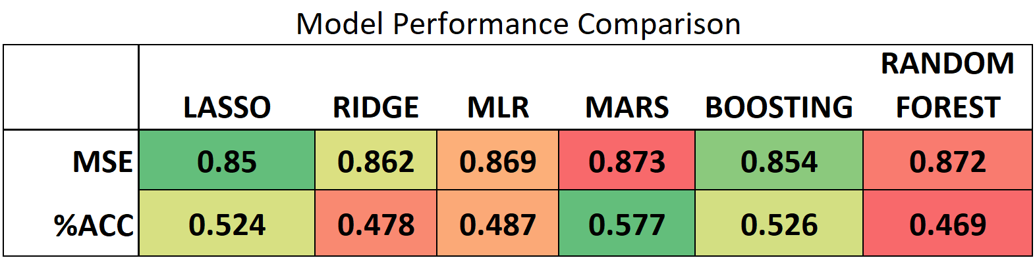
Methods - Results
LASSO Regression Shows Best Overall Cross Validation Performance
6 supervised learning models assessed, 10-Fold cross validation
%Acc = Number of predicted wins within half game of true wins
LASSO Regression Performance
>50% average accuracy and best MSE
Clear explanation of important features

Slide 10
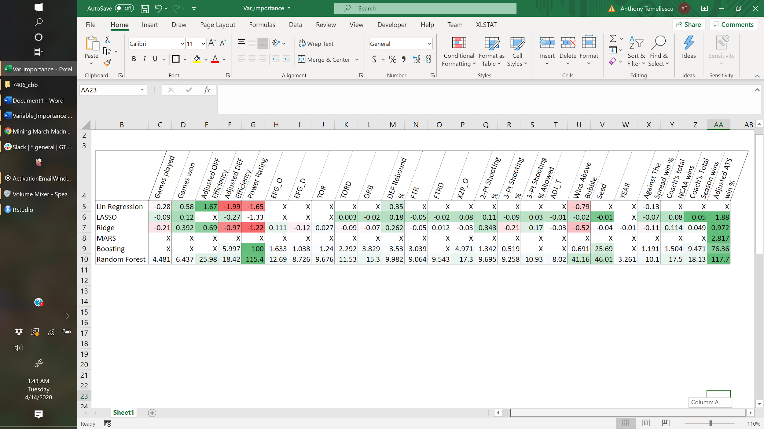
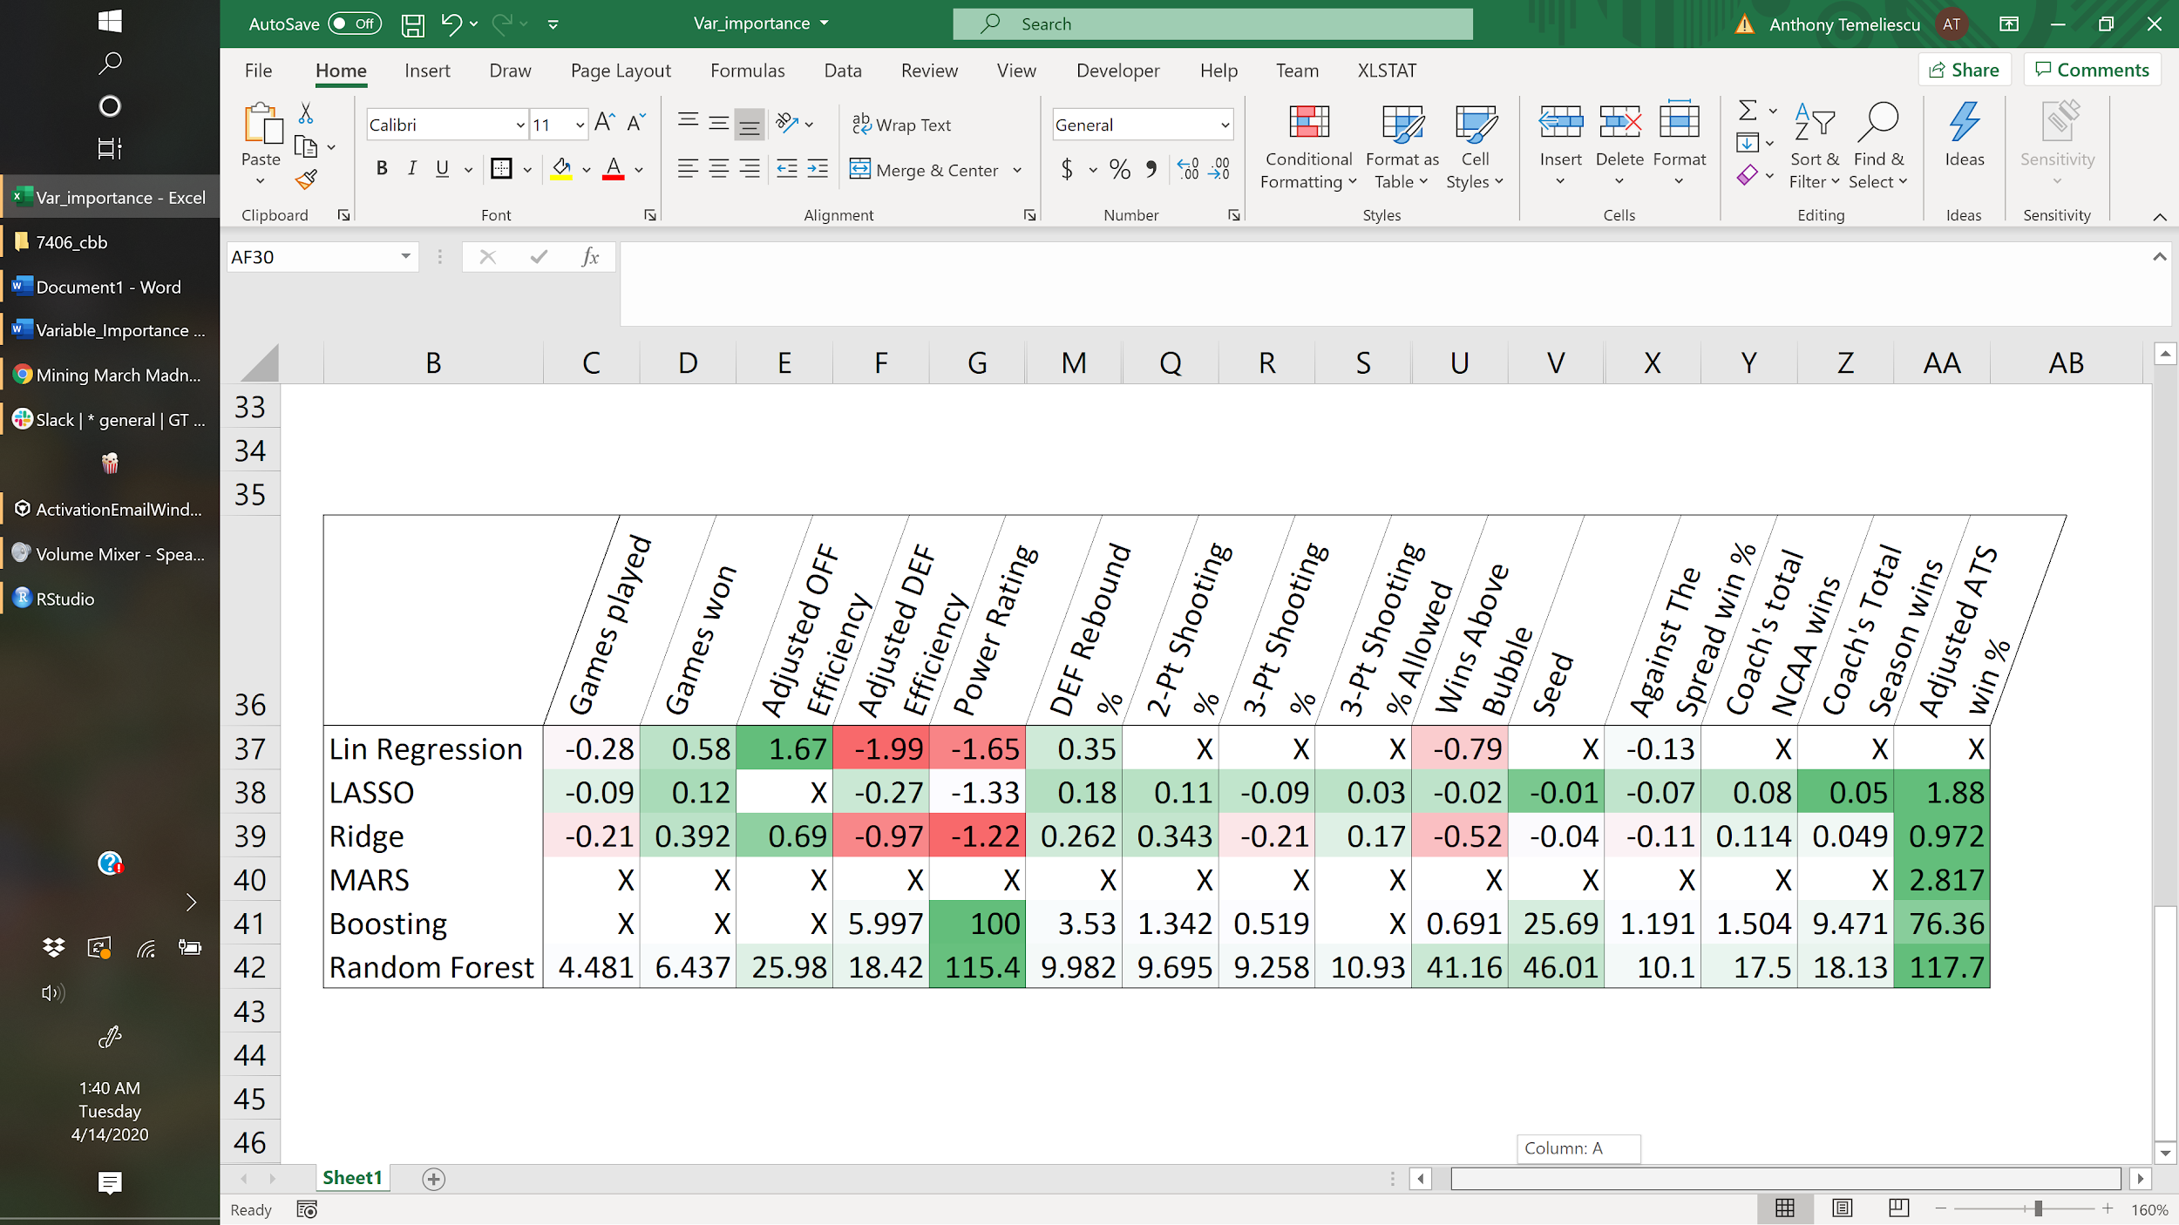
Methods - Conclusions
Adjusted DEF, Adjusted OFF, Power Rating, and the Adjusted Spread
Features were Important in All Models
truncated
Coaches can use this information to get a performance prediction and know which metrics to try to improve through recruitment and training.
The gambling industry is large.
Bettors can use this to create better betting brackets.

Slide 11
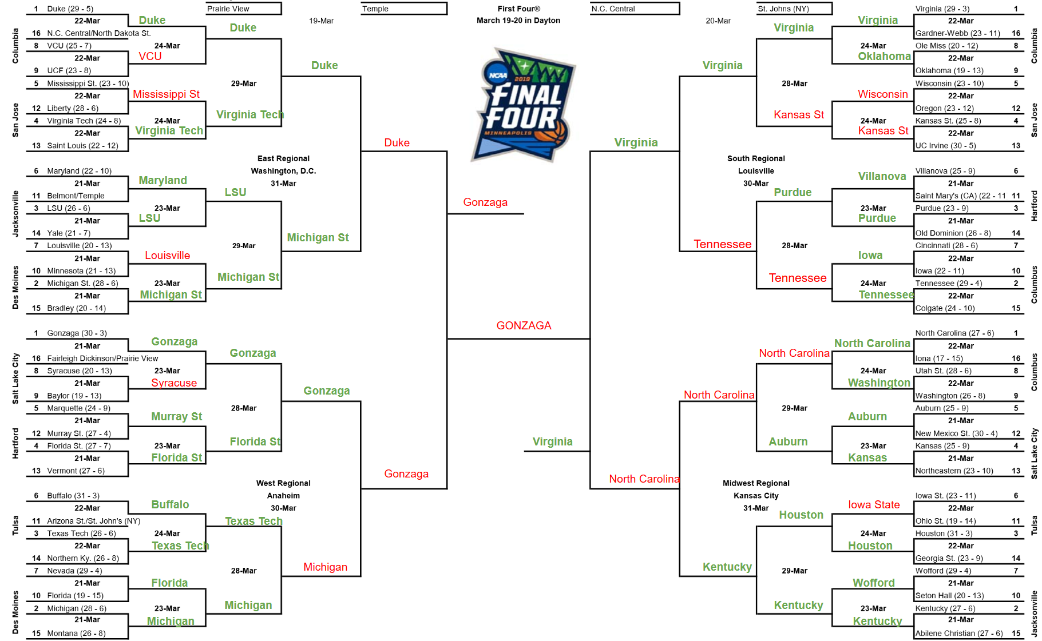
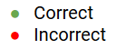
2019 Bracket Predictions
77.77% correct game predictions
¾ Final four teams successfully predicted

Slide 12
Future Work
Rerun models with more than 5 years of tournament data
Increase dataset granularity
Player specific data
Team position composition
Team game travel distances
Increased data size and different success metrics to better predict upsets
Notes:
Add to report - small event space limiting normal behavior of probabilistic models

